Slide 1
Welcome to Greyhoundderby’s Quiz 8

Slide 2
Target
In this first round you will be asked to identify the authors of 20 books. You will gain 50 pts for each you correctly identify.
Your target is to identify at least 15, so scoring 750 pts.
Your overall target, at the end of the quiz, is a mammoth 40,000 points.

Slide 3
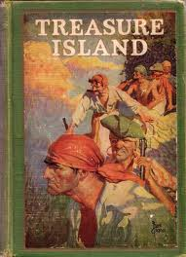
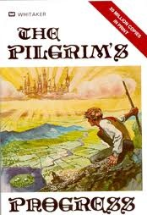
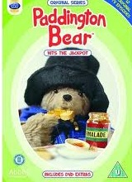
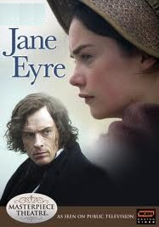
Who wrote the following books? 50 pts per book; 1000 if you get all 20.
1 | 2 | 3
4 | 5 | 6

Slide 4
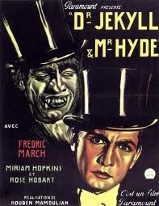
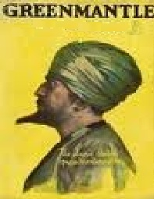
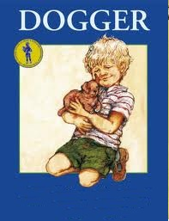
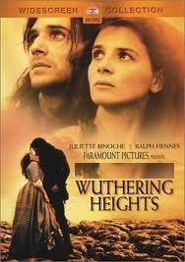
7 | 8 | 9
10 | 11 | 12

Slide 5
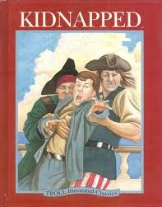
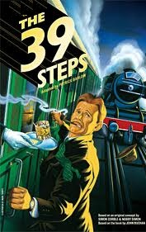
13 | 14
15 | 16

Slide 6
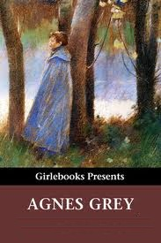
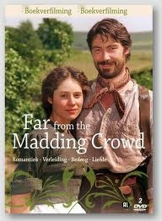
17 | 18
19 | 20

Slide 7
Book Authors 50 pts each 1000 for the lot
1 | Robert Louis Stevenson | 11 | Shirley Hughes
2 | John Bunyan | 12 | Emily Bronte
3 | Charles Dickens | 13 | Robert Louis Stevenson
4 | Michael Bond | 14 | John Buchan
5 | Shirley Hughes | 15 | Agatha Christie
6 | Charlotte Bronte | 16 | D H Lawrence
7 | Robert Louis Stevenson | 17 | Agatha Christie
8 | John Buchan | 18 | Anne Bronte
9 | Thomas Hardy | 19 | D H Lawrence
10 | Ian Fleming | 20 | Thomas Hardy

Slide 8
Target
Did you meet, or surpass, the target of 750 points?
In the next section there are 10 questions. For each question 5 possible answers are offered and you can gamble up to half the points you own on each question. Get it right and you add the points to your total, but choose an incorrect answer and you lose those points.
Your target by the end of the 10 questions is to achieve an overall total of 4000 points.

Slide 9
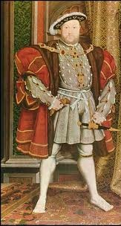
How tall was Henry VIII?
A | 5 ft 8 ins
B | 5 ft 10 ins
C | 6 ft
D | 6 ft 1 in
E | 6 ft 3 ins

Slide 10
How tall was Henry VIII ?
A | 5 ft 8 ins
B | 5 ft 10 ins
C | 6 ft
D | 6 ft 1 in
E | 6 ft 3 ins

Slide 11
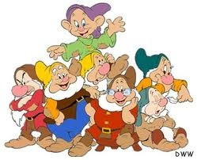
Which is the odd one out?
A | Boozy
B | Snoozy
C | Droopy
D | Dopey
E | Sleazy

Slide 12
Which is the odd one out?
A | Boozy
B | Snoozy
C | Droopy
D | Dopey
E | Sleazy

Slide 13
If these famous people were placed in order of their age, who would be in the middle?
A | The Queen
B | Prince Philip
C | Rupert Murdoch
D | David Attenborough
E | Margaret Thatcher

Slide 14
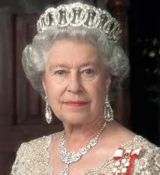
If these famous people were placed in age order, who would be in the middle?
A | The Queen 21st April 1926
B | Prince Philip 10th June 1921
C | Rupert Murdoch 11th March 1931
D | David Attenborough 8th May 1926
E | Margaret Thatcher 13th October 1925

Slide 15
Which of these books occurs latest in the Old Testament?
A | Habakkuk
B | Hosea
C | Micah
D | Nahum
E | Zephaniah

Slide 16
Which of these books occur latest in the Old Testament?
A | Habakkuk
B | Hosea
C | Micah
D | Nahum
E | Zephaniah

Slide 17
What symbol is on the same key as 7 on a computer keyboard?
A | £
B | *
C | %
D | ^
E | &

Slide 18
What symbol is on the same key as 7 on a keyboard?
A | £
B | *
C | %
D | ^
E | &

Slide 19
How many US States begin with the letter I ?
A | 1
B | 2
C | 3
D | 4
E | 5

Slide 20
Idaho
Illinois
Indiana
Iowa
A | 1
B | 2
C | 3
D | 4
E | 5

Slide 21
How many of the following are spelt correctly?
Tommorrow
Interuption
Parrallel
Lonliness
Wierd
A | 0
B | 1
C | 2
D | 3
E | 4

Slide 22
Tommorrow Tomorrow
Interuption Interruption
Parrallel Parallel
Lonliness Loneliness
Wierd Weird
A | 0
B | 1
C | 2
D | 3
E | 4

Slide 23
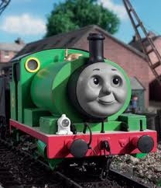
Who wrote the Thomas the Tank Engine books?
A | Rev. William Audry
B | Rev. Wilbert Audry
C | Rev. William Awdry
D | Rev. Wilbert Awdry
E | Rev. William Awdy

Slide 24
Who wrote the Thomas the Tank Engine books?
A | Rev. William Audry
B | Rev. Wilbert Audry
C | Rev. William Awdry
D | Rev. Wilbert Awdry
E | Rev. William Awdy

Slide 25
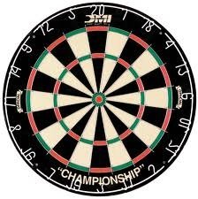
**A dartboard has 82 different sections. If I put one dart in each section what is the total score?
A | 1520
B | 1535
C | 1545
D | 1555
E | None of these totals

Slide 26
A dartboard has 82 different sections. If 1 dart is placed in each what is the total score?
A | 1520
B | 1535
C | 1545
D | 1555
E | None of these totals

Slide 27
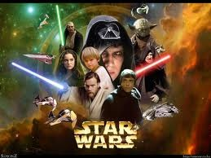
*When was Star Wars first released?
A | 25th May 1977
B | 27th May 1977
C | 27th May 1978
D | 29th May 1977
E | 29th May 1978

Slide 28
When was Star Wars first released?
A | 25th May 1977
B | 27th May 1977
C | 27th May 1978
D | 29th May 1977
E | 29th May 1978

Slide 29
Target
Did you meet, or even surpass, the target of 4000 points?
In this next round you have to identify African countries and will gain 200 points for each you recognise. Your target is to recognise at least 15, so earning 3000 pts.
Hence, your overall target is 7000 points.

Slide 30
How many African countries can you identify? 200 pts for each (4,000 for the lot)

Slide 31
African Countries 200 pts for each (4,000 for them all)
1 | A | 11 | M
2 | C | 12 | M
3 | C | 13 | M
4 | C | 14 | N
5 | C | 15 | N
6 | E | 16 | S
7 | E | 17 | S
8 | E | 18 | S
9 | K | 19 | T
10 | L | 20 | U

Slide 32
African Countries 200 pts for each (4,000 for them all)
1 | Algeria | 11 | Mali
2 | Cameroon | 12 | Mauritania
3 | Central African Republic | 13 | Morocco
4 | Chad | 14 | Niger
5 | Congo | 15 | Nigeria
6 | Egypt | 16 | Senegal
7 | Eritrea | 17 | Somalia
8 | Ethiopia | 18 | Sudan
9 | Kenya | 19 | Tunisia
10 | Libya | 20 | Uganda

Slide 33
Target
Did you meet, or even surpass, the target of 7000 points?
There now follows a further 10 ‘Winner Takes All’ questions where you can, once again, gamble up to half your points on each question.
Your target, by the end of the 10 questions, is to have at least 15,000 points.

Slide 34
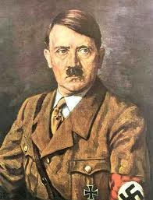
How tall was Hitler?
A | 5 ft 3 ins
B | 5 ft 5 ins
C | 5 ft 7 ins
D | 5 ft 8 ins
E | 5 ft 9 ins

Slide 35
How tall was Hitler?
A | 5 ft 3 ins
B | 5 ft 5 ins
C | 5 ft 7 ins
D | 5 ft 8 ins
E | 5 ft 9 ins

Slide 36
If the 7 Deadly Sins are placed in alphabetical order, which is in the middle?
A | Greed
B | Lust
C | Pride
D | Sloth
E | Wrath

Slide 37
Envy Gluttony Greed Lust Pride Sloth Wrath
A | Greed
B | Lust
C | Pride
D | Sloth
E | Wrath

Slide 38
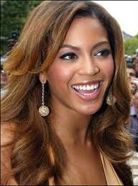
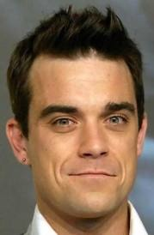
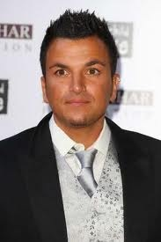
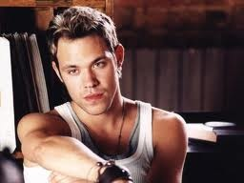
If these pop stars are placed in age order, who would be in the middle?
A | Beyonce
B | Will Young
C | Avril Lavigne
D | Robbie Williams
E | Peter Andre

Slide 39
If these Pop Stars were placed in age order, who would be in the middle?
A | Beyonce 4th Sept 1981
B | Will Young 20th Jan 1979
C | Avril Lavigne 27th Sept 1984
D | Robbie Williams 13th Feb 1974
E | Peter Andre 27th Feb 1973

Slide 40
How many books are there in the New Testament?
A | 26
B | 27
C | 28
D | 29
E | 30

Slide 41
How many books are there in the New Testament?
A | 26
B | 27
C | 28
D | 29
E | 30

Slide 42
Which letters are on either side of S on a computer keyboard?
A | AD
B | DA
C | DF
D | FD
E | AF

Slide 43
Which letters are on either side of S on a keyboard?
A | AD
B | DA
C | DF
D | FD
E | AF

Slide 44
How many US States begin with the letter N ?
A | 4
B | 5
C | 6
D | 7
E | 8

Slide 45
Nebraska New Hampshire
Nevada New Jersey
New Mexico New York
North Carolina North Dakota
A | 4
B | 5
C | 6
D | 7
E | 8

Slide 46
How many of the following are spelt correctly?
Aweful
Noticable
Separate
Liase
Definite
A | 0
B | 1
C | 2
D | 3
E | 4

Slide 47
Aweful Awful
Noticable Noticeable
Separate
Liase Liaise
Definite
A | 0
B | 1
C | 2
D | 3
E | 4

Slide 48
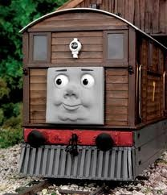
Who was the storyteller on the Thomas the Tank Engine programmes?
A | Ringo Starr
B | Paul McCartney
C | Bill Oddie
D | Bernard Cribbins
E | Timmy Mallett

Slide 49
Who was the storyteller on the Thomas the Tank Engine programmes?
A | Ringo Starr
B | Paul McCartney
C | Bill Oddie
D | Bernard Cribbins
E | Timmy Mallett

Slide 50
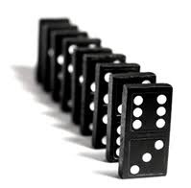
**How many spots are there in a standard set of dominoes?
A | 162
B | 164
C | 166
D | 168
E | None of these totals

Slide 51
How many spots are there on a standard set of dominoes?
A | 162
B | 164
C | 166
D | 168
E | None of these totals

Slide 52
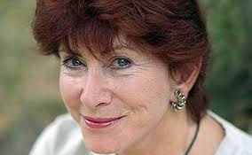
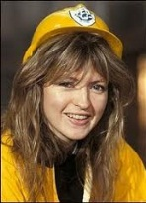
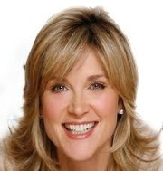
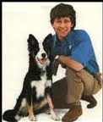
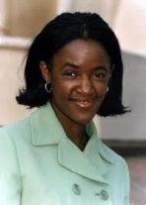
*Which of these 5 Blue Peters presenters lasted the shortest number of days?
A | Valerie Singleton
B | Caron Keating
C | Anthea Turner
D | John Noakes
E | Diane-Louis Jordan

Slide 53
Which of these 5 Blue Peter presenters lasted the shortest number of days?
A | Valerie Singleton 3592 days
B | Caron Keating 1167 days
C | Anthea Turner 652 days
D | John Noakes 4562 days
E | Diane-Louis Jordan 2224 days

Slide 54
Target
Did you meet, or even surpass, the target of 15,000 points?
There now follows a picture round in which you will gain 400 points for every one you correctly identify. Your target in this round is to recognise at least 15, so earning 6000 points.
Hence, your overall target at the end of this round is 21,000 points.

Slide 55
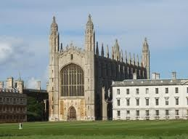
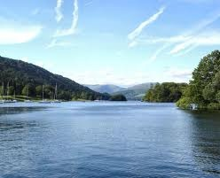
In which County (or metropolitan borough) are each of the following? 400 pts each (8,000 for the lot)
1 | 2
3 | 4

Slide 56
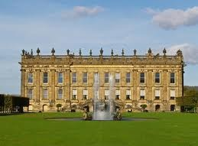
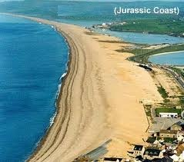
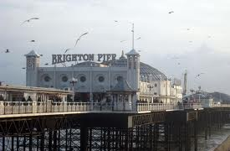
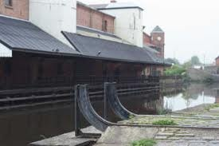
5 | 6
7 | 8

Slide 57
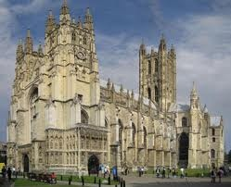
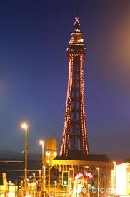
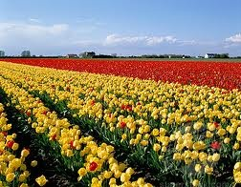
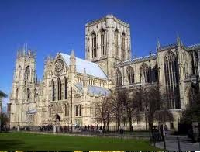
9 | 10
11 | 12

Slide 58
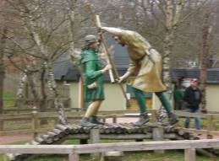
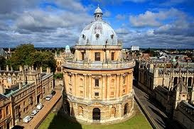
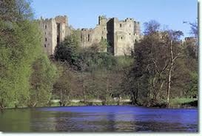
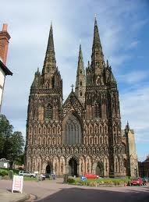
13 | 14
15 | 16

Slide 59
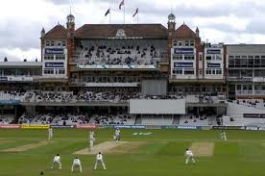
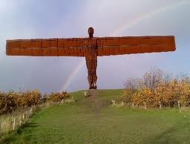
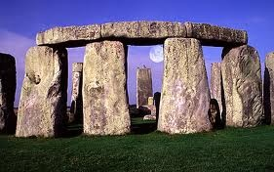
17 | 18
19 | 20

Slide 60
400 pts each (8,000 for them all)
1 | Bedfordshire | 11 | Lincolnshire
2 | Cambridgeshire | 12 | North Yorkshire
3 | Cornwall | 13 | Nottinghamshire
4 | Cumbria | 14 | Oxfordshire
5 | Derbyshire | 15 | Shropshire
6 | Dorset | 16 | Staffordshire
7 | East Sussex | 17 | Suffolk
8 | Greater Manchester | 18 | Surrey
9 | Kent | 19 | Tyne & Wear
10 | Lancashire | 20 | Wiltshire

Slide 61
Target
Did you meet, or even surpass, the overall target of 21,000 points?
You are now in the final furlong and finish with 10 ‘Winner Takes All’ questions. You can gamble up to half your points on each question.
Can you reach the final target of 40,000 points?

Slide 62
How tall is the Queen?
A | 5 ft
B | 5 ft 2 ins
C | 5 ft 4 ins
D | 5 ft 6 ins
E | 5 ft 7 ins

Slide 63
How tall is the Queen?
A | 5 ft
B | 5 ft 2 ins
C | 5 ft 4 ins
D | 5 ft 6 ins
E | 5 ft 7 ins

Slide 64
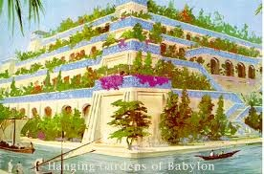
How many of the Seven Wonders of the Ancient World still exist today?
A | 0
B | 1
C | 2
D | 3
E | 4

Slide 65
Great Pyramid of Giza EXISTS
Hanging Gardens of Babylon VANISHED
Statue of Zeus at Olympia VANISHED
Temple of Artemis at Ephesus VANISHED
Mausoleum of Maussollos at Halicarnassus VANISHED
Colossus of Rhodes VANISHED
Lighthouse of Alexandria VANISHED
A | 0
B | 1
C | 2
D | 3
E | 4

Slide 66
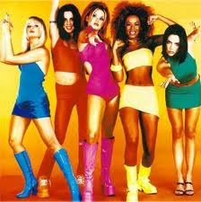
If the Spice Girls were placed in order of their age, who would be in the middle?
A | Mel B
B | Mel C
C | Emma Bunton
D | Posh Spice
E | Geri Halliwell

Slide 67
If the Spice Girls were placed in age order, who would be in the middle?
A | Mel B 29th May 1975
B | Mel C 12th Jan 1974
C | Emma Bunton 21st Jan 1976
D | Posh Spice 17th April 1974
E | Geri Halliwell 6th August 1972

Slide 68
Which of these books occur earliest in the Old Testament?
A | Daniel
B | Ezekiel
C | Joel
D | Jonah
E | Obadiah

Slide 69
Which of these books occur earliest in the Old Testament?
A | Daniel
B | Ezekiel
C | Joel
D | Jonah
E | Obadiah

Slide 70
Which letters are on either side of V on a computer keyboard?
A | XN
B | NX
C | BC
D | CB
E | CN

Slide 71
Which letters are on either side of V on a computer keyboard?
A | XN
B | NX
C | BC
D | CB
E | CN

Slide 72
What are the total number of US States beginning with the letters B E J Q R X Y Z ?
A | 0
B | 1
C | 2
D | 3
E | 4

Slide 73
Rhode Island
A | 0
B | 1
C | 2
D | 3
E | 4

Slide 74
How many of the following words are spelt correctly?
Grammar
Miniature
Professional
Receive
Recommend
A | 1
B | 2
C | 3
D | 4
E | 5

Slide 75
Grammar
Miniature
Professional
Receive
Recommend
A | 1
B | 2
C | 3
D | 4
E | 5

Slide 76
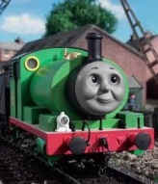
Which is the odd one out?
A | Percy
B | Toby
C | Gordon
D | Henry
E | James

Slide 77
Which is the odd one out?
A | Percy
B | Toby
C | Gordon
D | Henry
E | James

Slide 78
**Which Jacks have just one eye?
A | All of them
B | None of them
C | Hearts & Spades
D | Clubs & Diamonds
E | Hearts, Clubs & Spades

Slide 79
Which Jacks have only one eye?
A | All of them
B | None of them
C | Hearts & Spades
D | Clubs & Diamonds
E | Hearts, Clubs & Spades

Slide 80
*How many Dr Who’s have there been?
A | 8
B | 9
C | 10
D | 11
E | 12

Slide 81
How many Dr Who’s have there been?
William Hartnell Patrick Troughton John Pertwee
Tom Baker Peter Davison Colin Baker Sylvester McCoy
Paul McGann Christopher Eccleston David Tennant
Matt Smith
A | 8
B | 9
C | 10
D | 11
E | 12

Slide 82
Did you manage to reach 40,000 points?
That’s all folks

